Slide 1

Periodic
Business
Review
CybeReady
Nov 2023
Notes:
This slide deck contains many figures and graphs about your organization’s training. It’s built in a modular way that allows you to remove any slides that you don’t want or need to present to your managers.

Slide 2
Last Training Period
Start: Jul 1, 2021
End: Sep 30, 2021
Notes:
The following slides refer to the last training period, which is 3 months (or fewer, if you’re subscribed to CybeReady for less than that).

Slide 3
4506
41
6
10
👤Employees
👤joined
Languages
Locations
12,600
4,180
17,384
3,684
Simulations Sent
Reported Emails
Bites Sent
AuditReady Completions
Notes:
This slide summarizes some figures about the employees training in your organization.

Slide 4
9.5%
1.0%
Avg. Click Rate
High-Risk Employees
+0.3%
compared to previous period
-1.2%
compared to previous period
Phishing
21.0%
Avg. Click Rate of New Employees
+5%
compared to previous period
Notes:
These metrics that show how your organization fares against phishing.

Slide 5
59.6%
12.9%
Avg. Open Rate
Quiz Answer Rate
+2.8%
compared to previous period
+4.4%
compared to previous period
Awareness Content
72.1%
accumulated Open Rate
Notes:
These metrics show how well your organization is training towards security awareness.

Slide 6
Vulnerability
by Department
01 Jul 2021 – 30 Sep 2021
Notes:
The following slides examine departments in your organization that should be closely monitored or need extra training.

Slide 7
Most Vulnerable Departments
By Click Rate
Notes:
This graph shows the most vulnerable departments in terms of click rate: number of clicks divided by the number of simulations sent to employees in that department.

Slide 8
Most Vulnerable Departments
By Number of Clicks
Notes:
This graph shows the most vulnerable departments by number of phishing simulations clicks.
Even if a department is resilient on average, keep in mind that even one employee who is susceptible to phishing – is a vulnerability in your organization. You might also want to make sure that those departments don’t have access to sensitive data.

Slide 9
Departments in Declining Performance
Increase in Click Rate compared to previous period
Notes:
This graph shows the departments whose click rate has risen the most, compared to the previous training period. While some of them may not be the most vulnerable departments at the moment, they are worth monitoring.

Slide 10
Notable Phishing Simulations
01 Jul 2021 – 30 Sep 2021
Notes:
The following slides examine departments in your organization that should be closely monitored or need extra training.

Slide 11
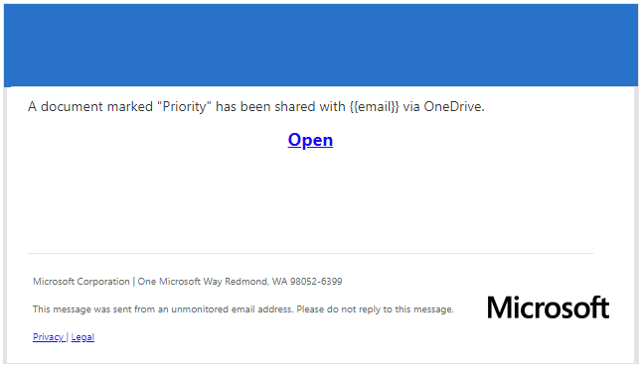
Most clicked-on simulation by veteran employees
From: OneDrive <info@...>
Subject: Document marked as “Priority” has been shared with you
Click Rate
15.5%
Notes:
This simulation had the highest click rate within veteran employees in your organization.
Veterans are employees who received at least 7 phishing simulations.

Slide 12
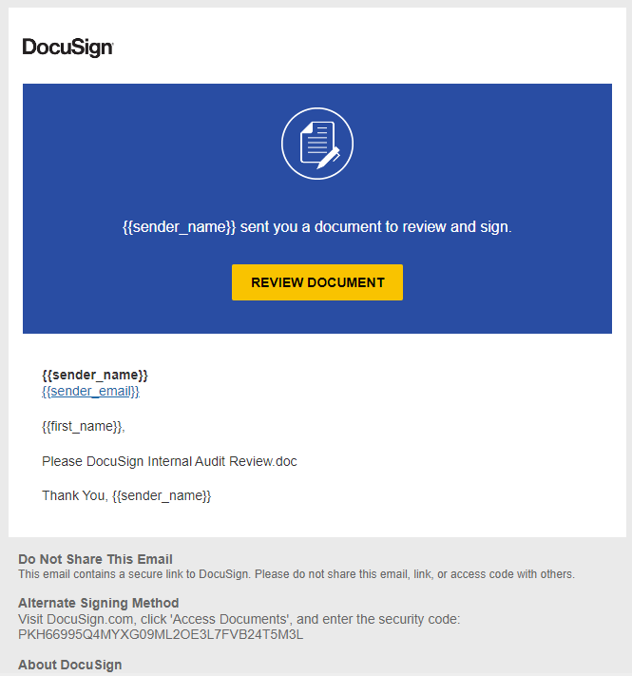
Most clicked-on simulation by beginner employees
From: Jake Baldwin <jbaldwin@...>
Subject: Please DocuSign: {{docusign_subject}}
Click Rate
34.3%
Notes:
This simulation had the highest click rate within new employees in your organization.
New employees are ones who received 6 or fewer phishing simulations.

Slide 13
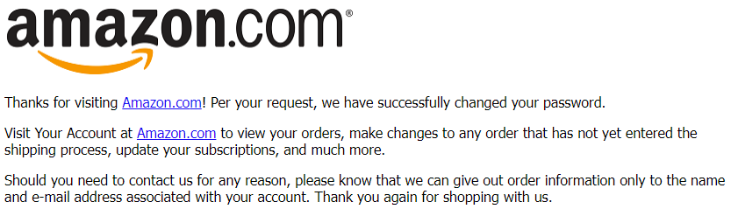
Least clicked-on simulation by all employees
From: Amazzon<account-update@...>
Subject: Revision to Your Amazon Account
Click Rate
3.4%
Notes:
This simulation had the lowest click rate in your entire organization.

Slide 14
Notable Awareness Bite
01 Jul 2021 – 30 Sep 2021
Notes:
The following slides examine departments in your organization that should be closely monitored or need extra training.

Slide 15
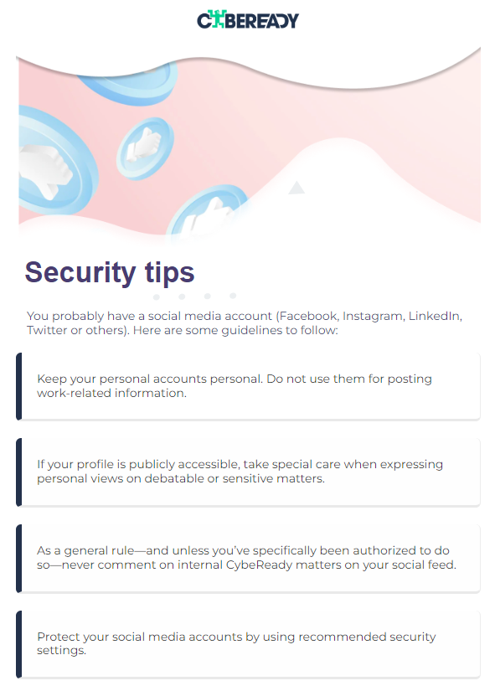
Most opened awareness bite
From: CybeReady Security Bites <do-not-reply@your-own-domain.net>
Subject: To post or not to post? (See tips on smart social media usage.)
Open Rate
34.3%
Notes:
This Awareness Bite had the highest open rate in your entire organization.

Slide 16
Long Term Analytics
Start: September 1, 2020
End: August 31, 2021
Notes:
The following slides refer to the last 12 months of training.

Slide 17
Phishing Risk Score Change
PhishCage Reporting Rate
Awareness Bites Open Rate
-31.9%
83.1%
80.8%
+60.1%
+65.4%
Notes:
This slide shows the training effectiveness across the CybeReady products you have activated.

Slide 18
High Risk Employees Trend
Notes:
The top graph shows the percentage of employees in your organization who are classified as “High Risk”.
The bottom graph shows the number of employees in your organization. If you see big changes in the top graph, they might be explained by big changes in the size of the company (like employee turnover or a hiring spree).
The x axis in the two graphs is the same, so you can easily fine correlations if necessary.

Slide 19
Click Rate
Notes:
This graph shows your organization’s click rate against the benchmark.
The benchmark is calculated using data from other organizations who received the same simulations as you.

Slide 20
Organization Breakdown
by Risk Groups
Notes:
This graph shows the percentage of each risk group in your organization, over time. The sum is always 100%.
Ideally, you’d want the High Risk group to be as small as possible, and the Low Risk to be as big as possible.
New employees always start as Medium Risk.

Slide 21
New vs. Veteran Employees
Notes:
The top graph shows the difference in phishing resilience between new and veteran employees. All employees are considered “New” until they receive at least 7 phishing simulations, at which point they become “Veterans”.
Normally, the New Employees line will be above the Veterans line, since they haven’t received as much training.
The bottom graph shows the number of employees in each seniority group. You can use this to explain things if you see any big changes in the top graph.

Slide 22
Number of Reported Emails by Type
Notes:
This graph shows the number of emails reported by employees in your organization, by the result of CybeReady’s analysis.
“Simulation” are phishing simulations we sent to your employees.
“Malicious” are emails that were classified as malicious by Google Safe Browsing.
“Unverified” are all the emails that Google Safe Browsing couldn’t classify as malicious.

Slide 23
Accumulated Reporting Rate
Notes:
This graph shows the percentage of employees in your organization who have reported at least one email through PhishCage.
If the graph trends downwards, it could be due to an increase in the number of employees in your organization.

Slide 24
Reporting Rate by Risk Group
Notes:
This graph shows the reporting rate of suspicious emails, by risk group.
Ideally, you’d want to see all graphs trending upward.

Slide 25
Open Rate
Notes:
This graph shows how employees in your organization interact with Awareness bites.
The main line shows the percentage of bites that were opened (out of all sent bites) in each campaign.
The other line shows the percentage of employees who opened at least one Awareness Bite during their training.

Slide 26
Awareness Bites Summary
Notes:
This graph shows how many Awareness Bites we sent and how many were opened in comparison.

Slide 27
Answer Rate
Notes:
This graph shows how employees in your organization interact with Awareness bites.
The main line shows the percentage of quizzes (in the bites) that were answered by employees.
The other line shows the percentage of employees who answered at least one Awareness Bite quiz during their training.

Slide 28
Organization Breakdown by Engagement Group
Notes:
This graph shows the percentage of each engagement group in your organization, over time. The sum is always 100%.
Ideally, you’d want the High Engagement group to be as big as possible, and the Low Engagement to be as small as possible.
New employees always start as Medium Engagement.

Slide 29
AuditReady Completion
85.9%
Completion rate in this cycle
Current cycle:
21 Oct 2020 – 20 Oct 2021
Notes:
This slide shows the percentage of employees in your organization who have read and signed your AuditReady program.

